Slide 1
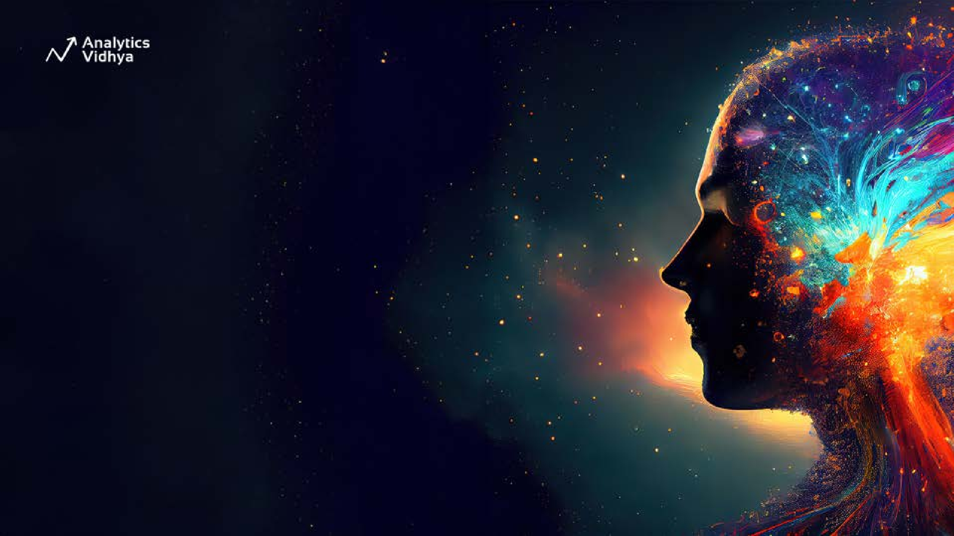
Getting Started with Stable Diffusion
1

Slide 2
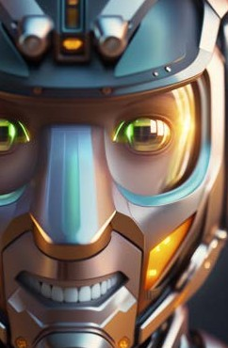
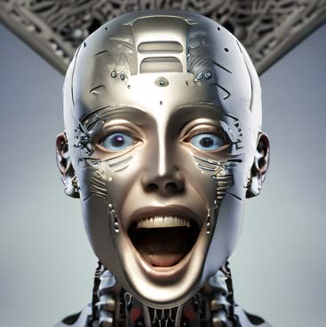
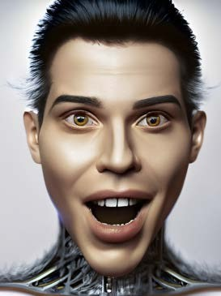
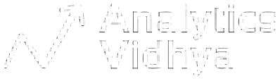
Excited?

Slide 3
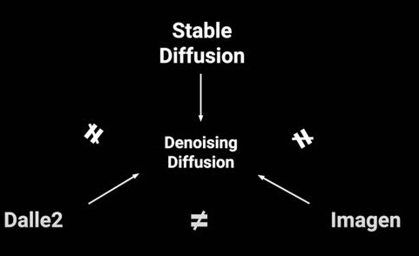
Stable Diffusion: Why Care?
Most Text-to-Image techniques are inspired by this!
Poster Child of Text-to-Image Model

Slide 4
Stable Diffusion: Why Care?
First Open Source State of Art Diffusion Model
Inspired by Physics of Fluids/Gases

Slide 5
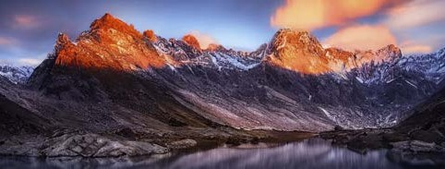
Stable Diffusion: Why Care?
Improved Image Reconstruction
Robustness to Variability, more resilient to changes in illumination, contrast
Enhanced Edge Preservation

Slide 6
History behind Stable Diffusion
7

Slide 7



Pre-Stable Diffusion Models Era
Text-to-image models had an amazing 2022
The State of Art has moved by leaps and bounds
April
OpenAI Released DALL·E 2
July
Midjourney
2022
May
Google Released Imagen

Slide 8
Researchers where left High and Dry
No community validation available.
Pre - Stable Diffusion Model Era: Issues
Everything was Proprietary and Closed Source.
Fine-tuning models wasn't easily accessible outside big AI research labs.

Slide 9
Stable Diffusion: Shining Star
11

Slide 10


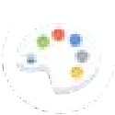
Stable Diffusion: Shining Star
April
OpenAI Released DALL·E 2
July
Midjourney
2022
August
Stability AI Released
Stable
Diffusion
May
Google Released Imagen

Slide 11
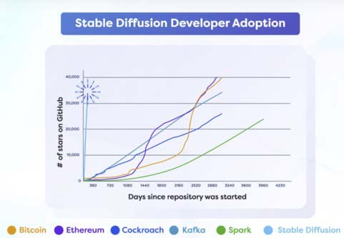
Stable Diffusion: Shining Star
Released as:
Open Source Code and Model Weights
Took the Developers Community by Storm as fast growing Open Source project. 30K Stars on Github!

Slide 12
Stable Diffusion: Shining Star
Simplistic and Beautiful Code
Diffusion approach: main focus of excitement.

Slide 13
Stable Diffusion: Shining Star
Most Important: Commodity Consumer Hardware was enough to finetune.

Slide 14
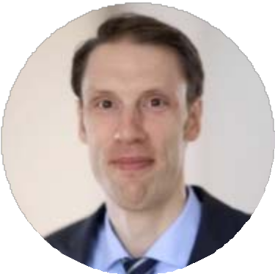


Stable Diffusion:
Latent Diffusion Models
Prof. Dr. Bjorn Ommer
Comp-Vis Lab
Patrick Esser
RunwayML
Robin Rombach
StabilityAI

Slide 15


Stable Diffusion: Prominent Companies
Companies that supported early development of Stable Diffusion

Slide 16

Open Source Code
Stability.AI released Stable Diffusion with three crucial features for community research and development
Stable Diffusion
Features
Fast to Train and Fine-tune
Capable on running Consumer GPUs

Slide 17
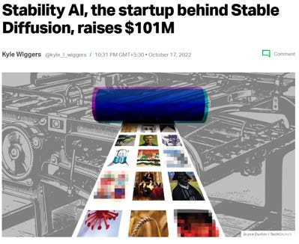
Stable Diffusion: Shining Star
Aug,2022 release of Stable Diffusion, helped Stability AI raise 101M USD in OCT,2022!

Slide 18

Stable Diffusion: Shining Star
Research and development of early version of Stable Diffusion was at the expense of 600k USD
20

Slide 19
Stable Diffusion: Shining Star
Stable Diffusion was released to public for research and fine-tuning

Slide 20
Stability AI ignited this great Text-Image-Movement

Slide 21

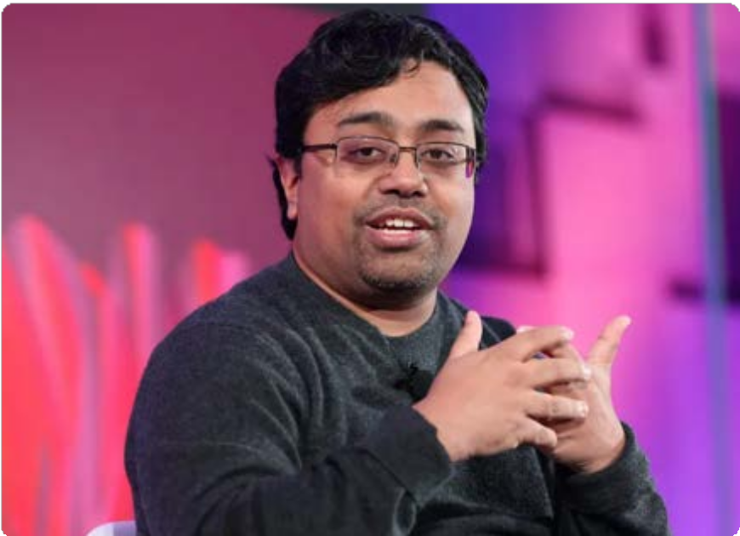
Stable Diffusion: Stability AI
Stability.AI was founded by Emad, who was Hedge Fund Manager for 13 years

Slide 22
Stable diffusion 2.0 and 2.1
25

Slide 23
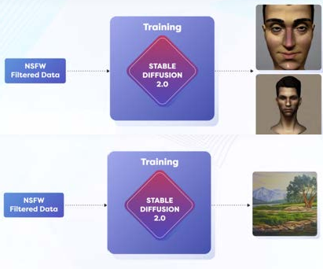
Stable Diffusion 2.0
Released in November 2022
Improvements
Content Moderation No NSFW Data
New Text Encoder: OpenCLIP
Better at creating non-human body like artifacts

Slide 24
Stable Diffusion 2.0
Released in November 2022
Limitations
Removal of NSFW data caused limitation of face generations
These limitations were addressed in v2.1

Slide 25
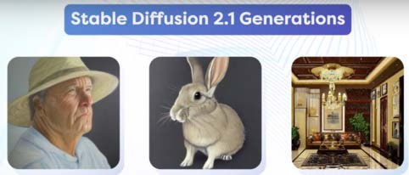
Stable Diffusion 2.1
The first awesome version!
Human faces were highly detailed
The lighting and contrast were much better

Slide 26
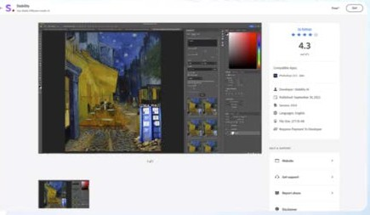
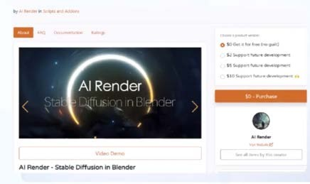
Stable Diffusion 2.1
These plugins boosted the adoption at unimaginable speed by Artists and Non-tech Community
Photoshop Plugins in September 2022
Blender Plugins in March 2023

Slide 27
Stable Diffusion: Blockbuster Month - April 2023
The releases opened the floodgates of new research on top of SD as:
WebUI
Civit.AI
Stable Diffusion
ControlNet
Robo Diffusion
InstructPix2Pix
Mo-Di Diffusion

Slide 28
Basic Stable Diffusion Intuition
39

Slide 29
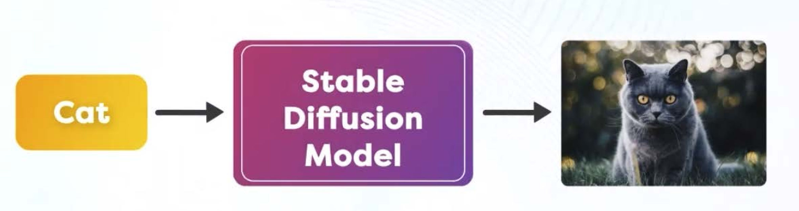
Stable Diffusion: Intuition
The Stable Diffusion Model allows us to input text, which it then uses to create an image.
40

Slide 30
Stable Diffusion: Intuition
But it does NOT convert Text to Image. Instead, It Converts Noise into Image. By the guidance of Text by performing Reverse Diffusion.

Slide 31
Stable Diffusion: Intuition
But it does NOT convert Text to Image. Instead, It Converts Noise into Image. By the guidance of Text by performing Reverse Diffusion.

Slide 32
Stable Diffusion:
A multi-model tool that can understand both text and images

Slide 33
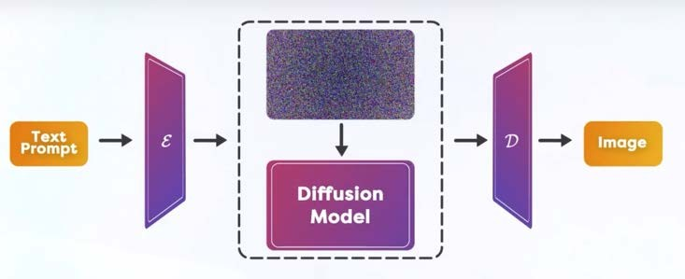
Stable Diffusion: Intuition
Reverse Diffusion
Text prompt guides, how to alter the Noisy Image so that:
“Altered Noisy Image looks little bit more like Description as in Text”

Slide 34
Examples of Basic Stable Diffusion Intuition
46

Slide 35
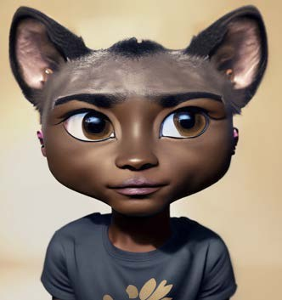
Stable Diffusion: Intuition - Guidance
For the Input Text “Boy”, we have an image generated as here.

Slide 36


Stable Diffusion: Intuition - Guidance
What is wrong with the Image of the Boy?
Ears and Head needs to change.

Slide 37
Stable Diffusion: Intuition - Guidance
So, the Text “Boy” guides you to change “ears”.
In Stable Diffusion, this guidance is at the Pixel level.
Text in encoded form tells us which pixels need to change by a slight amount.

Slide 38
Stable Diffusion: Reverse Diffusion
51

Slide 39
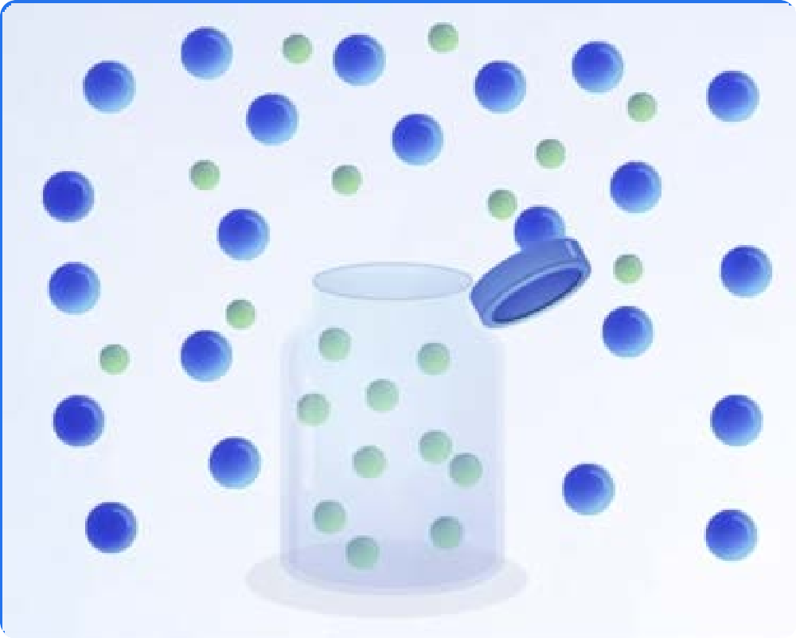
Stable Diffusion: Intuition
Reverse Diffusion
What is Diffusion?
Molecules move from an area of higher concentration to an area of lower concentration to achieve equilibrium.

Slide 40

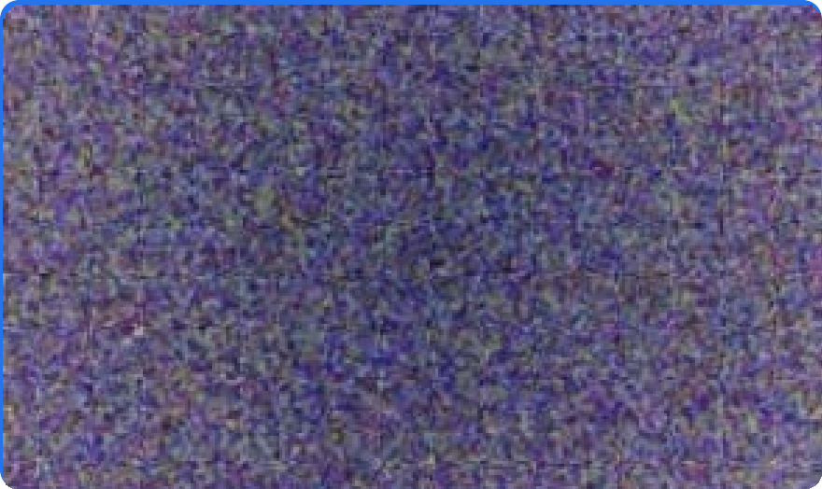
Stable Diffusion: Intuition
Reverse Diffusion
What is Diffusion? (In the context of Stable Diffusion)
A diffused state in Images can be imagined as- True Noisy Image.
After fully reverting this diffusion of noise, we construct- Image described by Text.

Slide 41
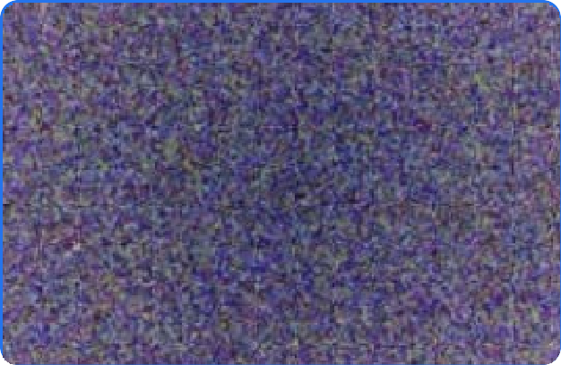
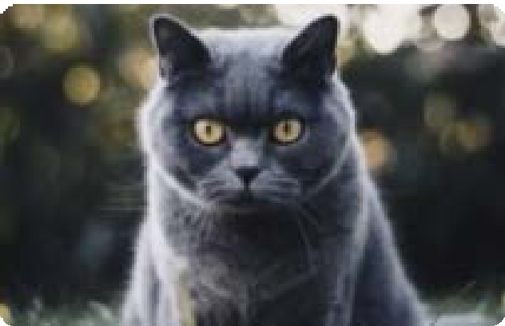

Stable Diffusion: Intuition
Reverse Diffusion
Technique that slightly modifies the pixels of a noisy image to make it more similar to the input text.
Denoising
Fully Diffused Image/ True Noisy Image
Cat: After many Reverse Diffusion
Reverse Diffusion is called: “Denoising”

Slide 42
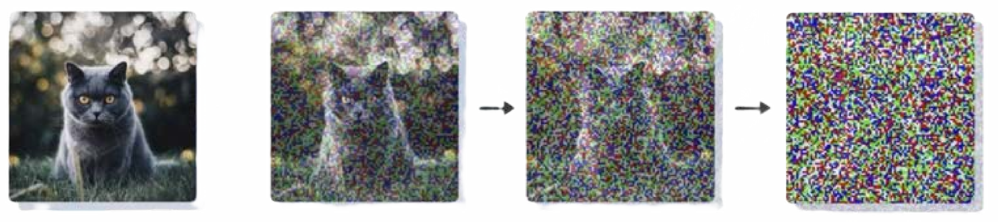



Stable Diffusion: Intuition
Noising
Forward Diffusion
Reverse Diffusion
Denoising
Note: x₀ is Denoised Image, x_{T} is Image with added Noise T times.

Slide 43
Stable Diffusion: Purpose
57

Slide 44
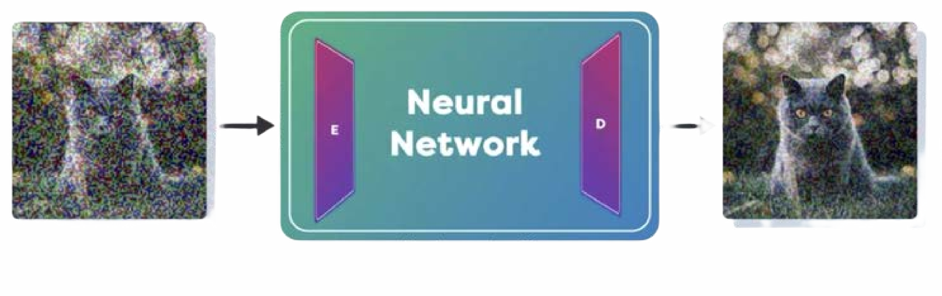
Stable Diffusion: Purpose
Noisy Image
Less Noisy Image
At Every Step of Reverse Diffusion, we want to:
Calculate the Noise on Current Image
Remove the Noise from Current Image Repeat

Slide 45



Stable Diffusion: Purpose
Noisy Image
Less Noisy Image
So, Stable Diffusion is:

Slide 46
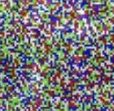

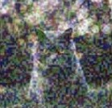


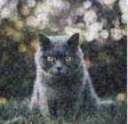

Stable Diffusion: Purpose
Noise is calculated easily with Neural Networks, and Unet is popular network for the same.
-
We cannot estimate all the error in one step, we do it slowly and Diffusion Process remains “Stable”.
Too fast and too big change causes “Instability”.
60

Slide 47
UNet
62

Slide 48
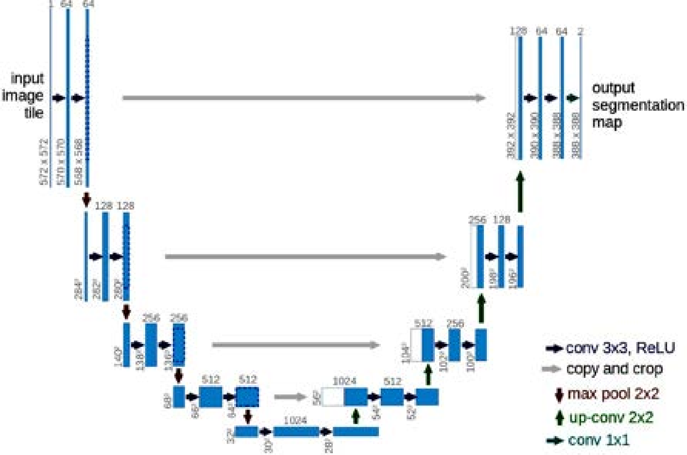
Stable Diffusion: A bit about UNet
Originally envisioned for Medical Image Segmentation tasks,
Later, repurposed heavily for many image-2-image tasks.

Slide 49
Stable Diffusion: A bit about UNet
Have Convolutional Encoder(Down-sampling) and Decoder(Up-sampling) parts.

Slide 50
Stable Diffusion: A bit about UNet
Learns Modulations at Multi-Scale and Multi-Abstraction Levels.
Lateral Skip Connections are the Secret sauce compared to VAE.

Slide 51
Latents
67

Slide 52

Stable Diffusion needs to perform very small amount of changes during Denoising to keep denoising stable.
Problem
Diffusion is Slow, Takes Long Time

Slide 53
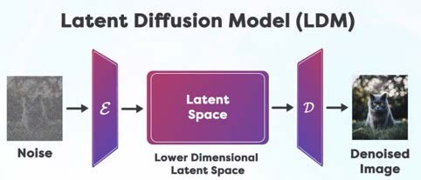
Stable Diffusion: Now Latents
To Speedup the Diffusion Process: We Reduce the side of Starting Noisy Image.
This reducing of Starting Image is: Encoded into Latent Space

Slide 54
Stable Diffusion: Now Latents
Denoising is performed on Latents.
Denoised Latents are: Decoded from Latent Space
Decoder outputs the Final Image
70

Slide 55

Stable Diffusion works on Encode Image into Latent Space
Solution
Speed-up the Denoising Process

Slide 56

There are other models, that work directly on original Image as Google’s Imagen

Slide 57
CLIP - Part I
75

Slide 58
How can we use text as a guide to calculate the amount of noise?

Slide 59
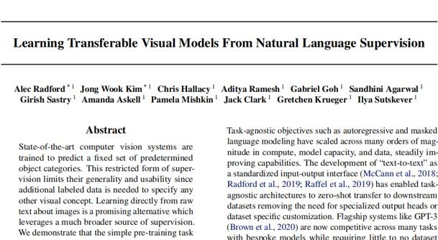
Stable Diffusion: What About Text?
Text is Encoded into its
Own Latent Space
Text and image interaction in latent space is key to all text- to-image models.
Clip Paper was released in Jan 2022

Slide 60
This phenomenon blurred the lines between Text and Image Models

Slide 61
What is CLIP?

Slide 62
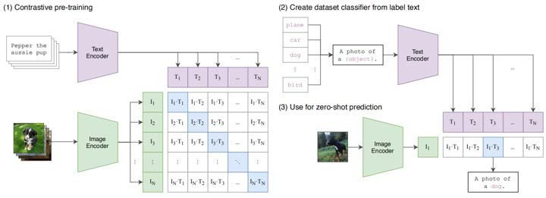
Stable Diffusion: CLIP
CLIP (Contrastive Language-Image Pre-training) trains an image encoder and a text encoder to predict correct pairings. Link: https://arxiv.org/abs/2103.00020
Train a Model using “Image - Caption” pairs, So, Captions for similar images will have Embeddings nearby in Latent Space.
80

Slide 63
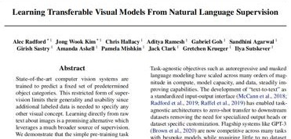

Stable Diffusion: Clip Intuition
Crux of the CLIP Paper:
The CLIP model consists of a text and an image encoder which encodes textual and visual information into a multimodal embedding space.

Slide 64
CLIP - Part II
83

Slide 65
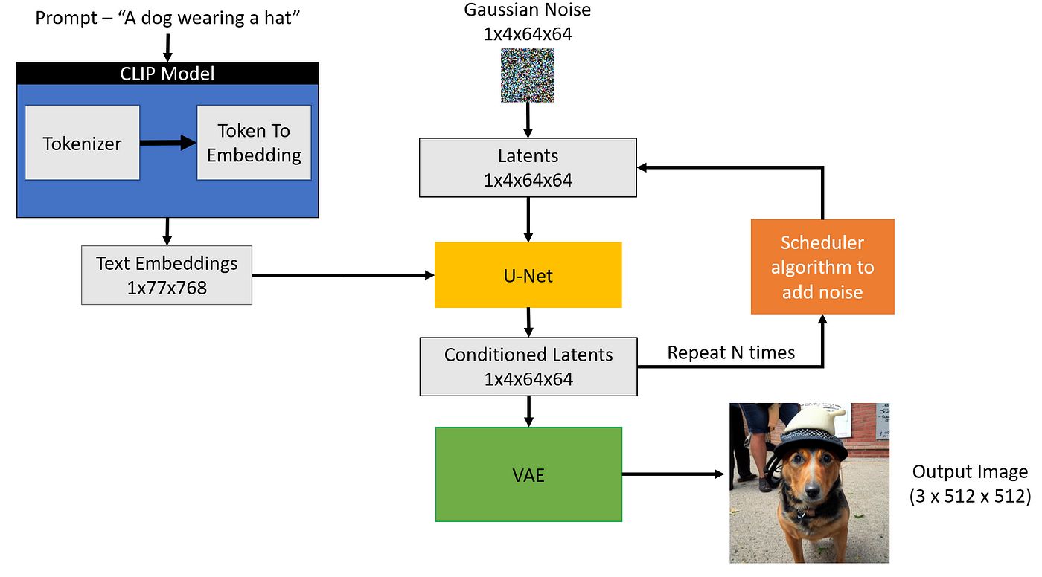

Slide 66
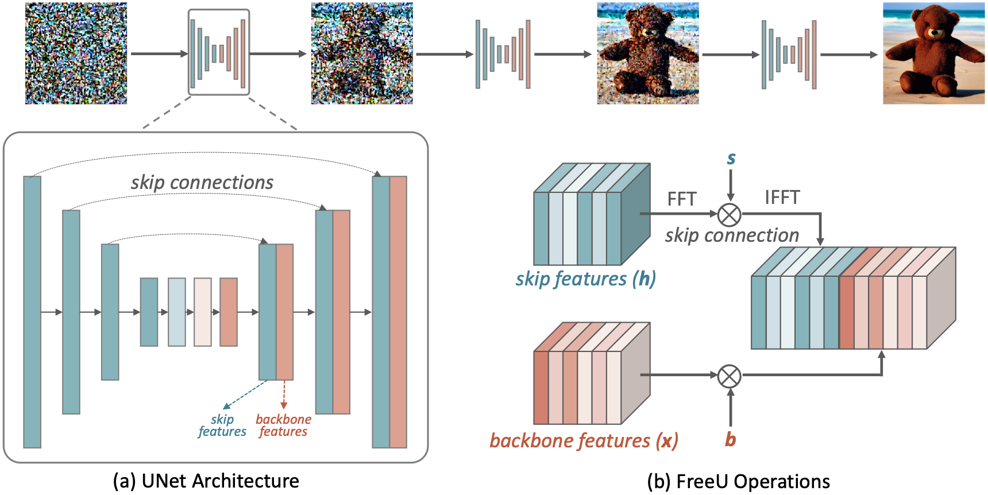

Slide 67
Stable Diffusion: Clip Intuition
Aim the CLIP Paper:
Improve cosine similarity score between associated images and text.

Slide 68
Stable Diffusion: Clip Intuition
CLIP Trained Models, Helps us:
Encode Texts and Image
in a way where Text and Image Embeddings with similar meanings are nearby in Vector Space.

Slide 69
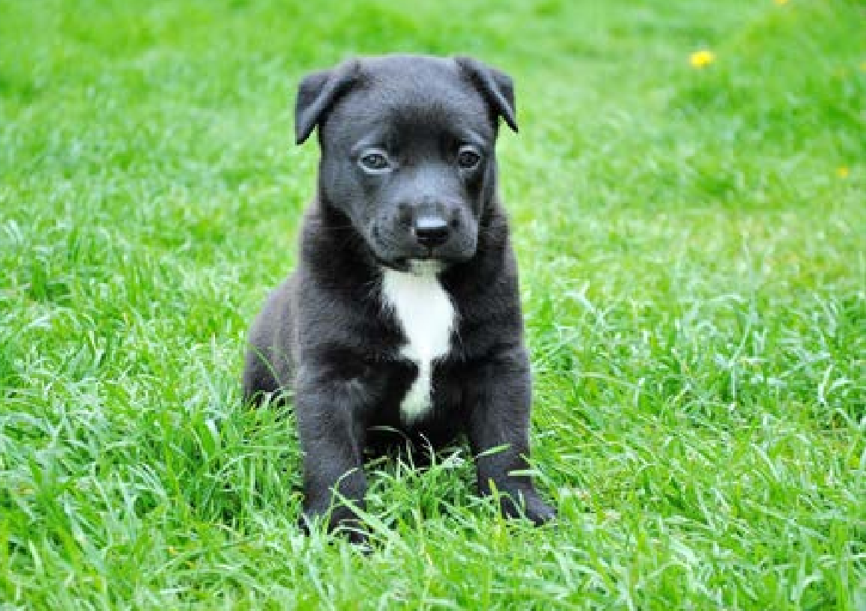
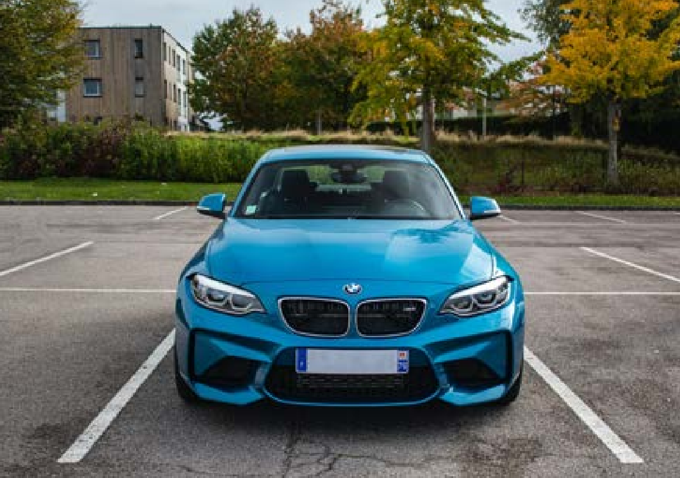
Stable Diffusion: Clip Intuition
Encoded Text embeddings for “dog” or “puppy” will be MORE cosine similar to this Encoded Image
Encoded Text embeddings for “dog” or “puppy” will be LESS cosine similar to this Encoded Image

Slide 70
Quantity which is more for not-matching Text and Image and less for matching Text and Image is called: “Contrastive Loss”

Slide 71
Connecting the Pieces - Part 1
90

Slide 72
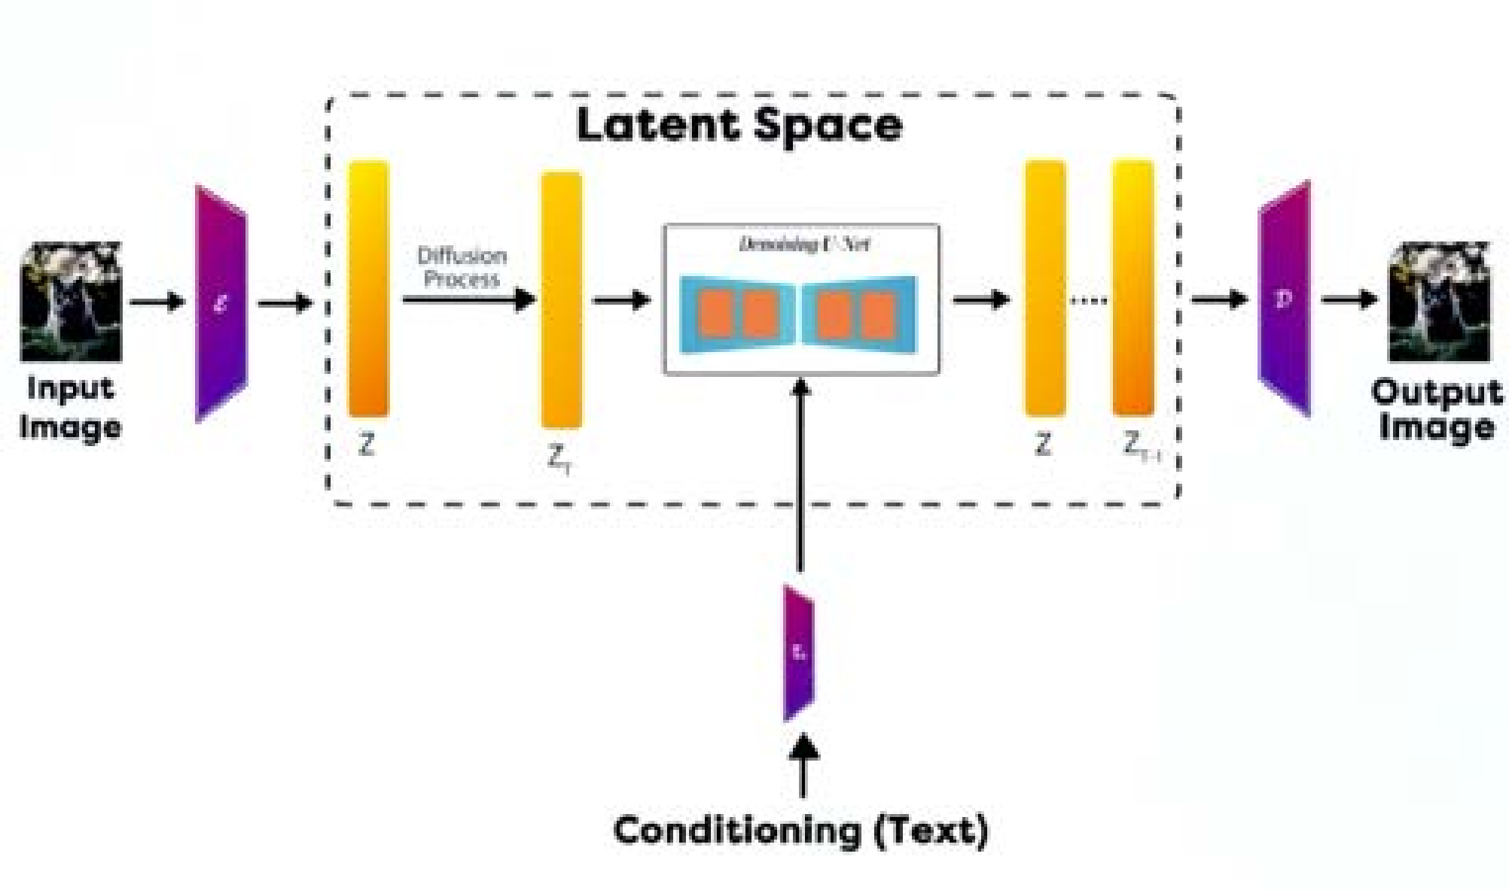
Stable Diffusion: How it all Fits in?
Text Embeddings: Determine text similarity through embeddings.
Denoising U-Net Training: Train U-Net in latent space using scheduled noise data.

Slide 73
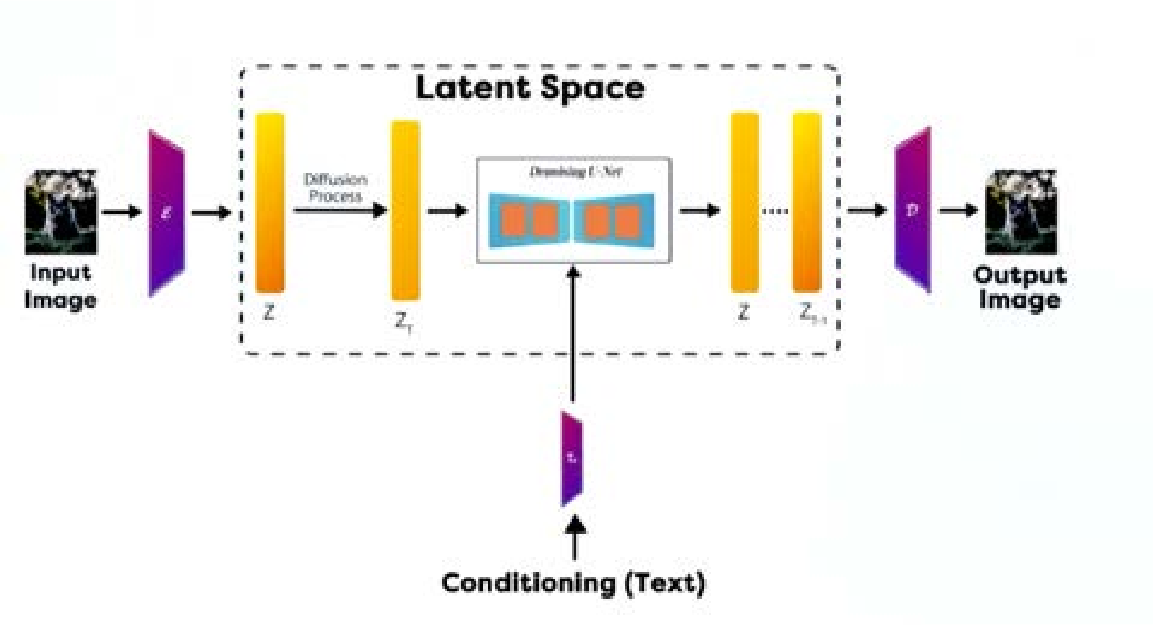
Stable Diffusion: How it all Fits in?
Noise Calculation: Assess image noise using encoded text input.
Encoder and Decoder are part of Variational Autoencoder (VAE), which we will see in a bit.

Slide 74
Connecting the Pieces - Part II
94

Slide 75






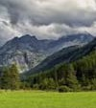



Stable Diffusion: How it all Fits In?
{ }
}
Training: We add noise by known amount and try to denoise it as per text. Do it Millions of times.
Training
{
Denoising U-Net
Inference

Slide 76
Stable Diffusion: How it all Fits In?
{ }
}
Inference: We just reduce noise from random noise slowly as per text. Keep doing it until denoised image is as expected
Training
{
Denoising U-Net
Inference

Slide 77
Stable Diffusion: How it all Fits In?
{ }
}
This process is called: DDPM: Denoising
Diffusion Probabilistic Model.
Training
{
Denoising U-Net
Inference
Link: https://arxiv.org/abs/2006.11239

